Slide 1
Building GUIs in MATLAB
Eddy Barratt
16th December 2016

Slide 2
Why use GUIs?
Object Oriented Programming
An example GUI Class
Constructor
Callbacks
In Actions.

Slide 3
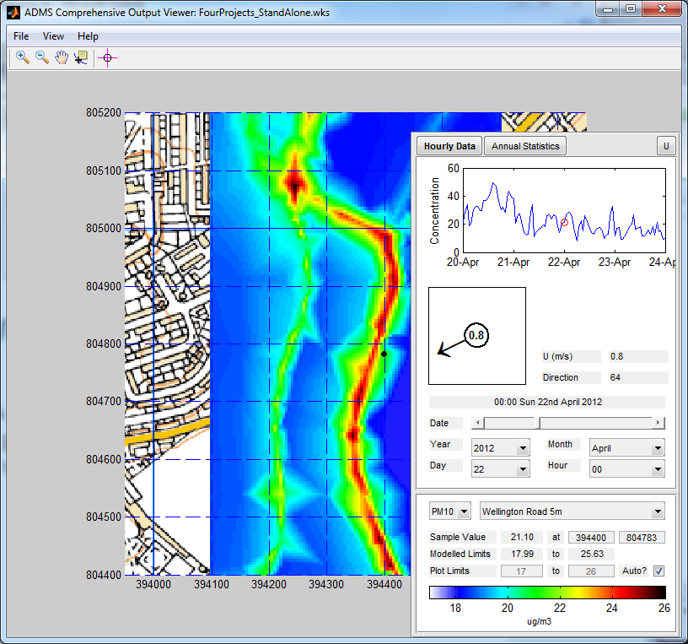
Why GUIs?
Why GUIs?
Object Oriented
A GUI Class
Constructor
Callbacks
In Action
A well designed Graphical User Interface (GUI)
provides an intuitive way for a user to interact
with a complex computer programme.
Stand by for a MATLAB GUI demonstration...
Notes:
Have the FourProjects DisplayADMS workspace already open.

Slide 4
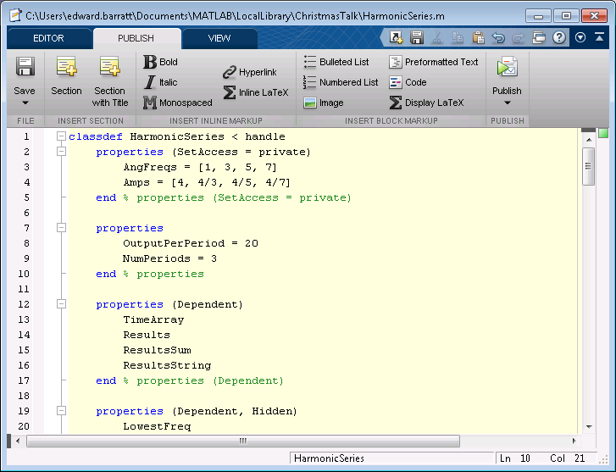
Object Oriented Programming
Why GUIs?
Object Oriented
A GUI Class
Constructor
Callbacks
In Action
Object Oriented programming involves creating classes that contain properties and methods related to the objects they represent.

Slide 5
Object Oriented Programming
Watch as I code...
>> HS = HarmonicSeries([1,2,3], [4, 2, 4])
HS =
HarmonicSeries with properties:
AngFreqs: [1 2 3]
Amps: [4 2 4]
OutputPerPeriod: 20
NumPeriods: 3
TimeArray: [1x181 double]
Results: [3x181 double]
ResultsSum: [3x181 double]
ResultsString: 'y = 4sin(1x) + 4sin(3x) + 2sin(2x)'
>> HS.AngFreqs = [23, 45]
You cannot set the read-only property 'AngFreqs' of HarmonicSeries.
>> HS.SetFreqsAndAmps([23, 45], [5, 6])
>> HS
HS =
HarmonicSeries with properties:
AngFreqs: [23 45]
Amps: [5 6]
OutputPerPeriod: 20
NumPeriods: 3
TimeArray: [1x118 double]
Results: [2x118 double]
ResultsSum: [2x118 double]
ResultsString: 'y = 6sin(45x) + 5sin(23x)'
Why GUIs?
Object Oriented
A GUI Class
Constructor
Callbacks
In Action
>> HS = HarmonicSeries
HS =
HarmonicSeries with properties:
AngFreqs: [1 3 5 7]
Amps: [4 1.3333 0.8000 0.5714]
OutputPerPeriod: 20
NumPeriods: 3
TimeArray: [1x421 double]
Results: [4x421 double]
ResultsSum: [4x421 double]
ResultsString: [1x59 char]
>> HS = HarmonicSeries([1,2,3])
HS =
HarmonicSeries with properties:
AngFreqs: [1 2 3]
Amps: [1 1 1]
OutputPerPeriod: 20
NumPeriods: 3
TimeArray: [1x181 double]
Results: [3x181 double]
ResultsSum: [3x181 double]
ResultsString: 'y = 1sin(1x) + 1sin(2x) + 1sin(3x)'

Slide 6
Object Oriented Programming
Why GUIs?
Object Oriented
A GUI Class
Constructor
Callbacks
In Action
Classes are self contained objects with properties and methods.
Classes can be called by other programmes, or stand alone.

Slide 7
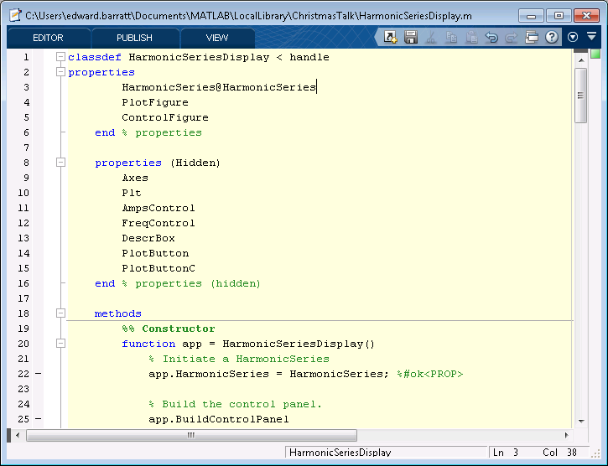
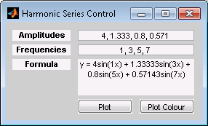
A GUI Class
Why GUIs?
Object Oriented
A GUI Class
Constructor
Callbacks
In Action
Classes can raise, control, and be controlled by figures.

Slide 8
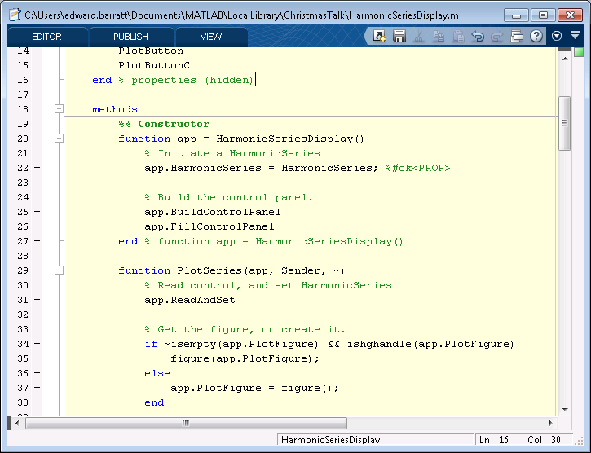
A GUI Class
Constructor
Constructor defines the “HarmonicSeries” property by initialising a HarmonicSeries object.
Why GUIs?
Object Oriented
A GUI Class
Constructor
Callbacks
In Action
Then it calls the “BuildControlPanel” method
Followed by the “FillControlPanel” method

Slide 9
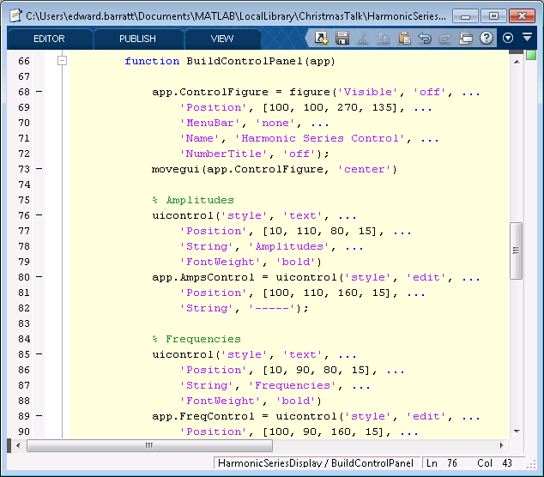
A GUI Class - uicontrol
BuildControlPanel method
Define the ControlFigure property, which is a MATLAB figure object.
Why GUIs?
Object Oriented
A GUI Class
Constructor
Callbacks
In Action
Define various User Interface Controls and place them within the figure.

Slide 10
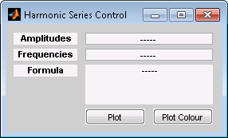
A GUI Class - uicontrol
BuildControlPanel method
Define the ControlFigure property, which is a MATLAB figure object.
Why GUIs?
Object Oriented
A GUI Class
Constructor
Callbacks
In Action
Define various User Interface Controls and place them within the figure.

Slide 11
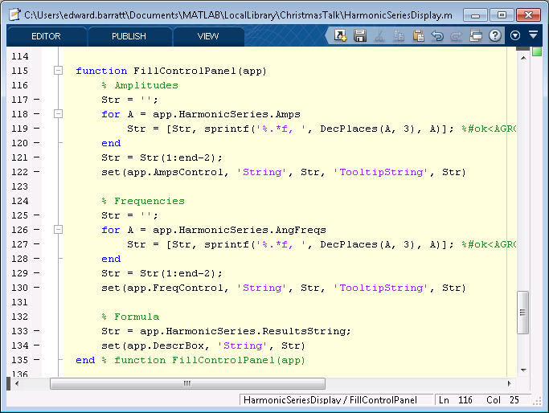
A GUI Class - uicontrol
FillControlPanel method
Use the values from the HarmonicSeries object to define strings.
Why GUIs?
Object Oriented
A GUI Class
Constructor
Callbacks
In Action
And set the ‘String’ properties of the uicontrol objects.

Slide 12

A GUI Class - uicontrol
FillControlPanel method
Use the values from the HarmonicSeries object to define strings.
Why GUIs?
Object Oriented
A GUI Class
Constructor
Callbacks
In Action
And set the ‘String’ properties of the uicontrol objects.

Slide 13
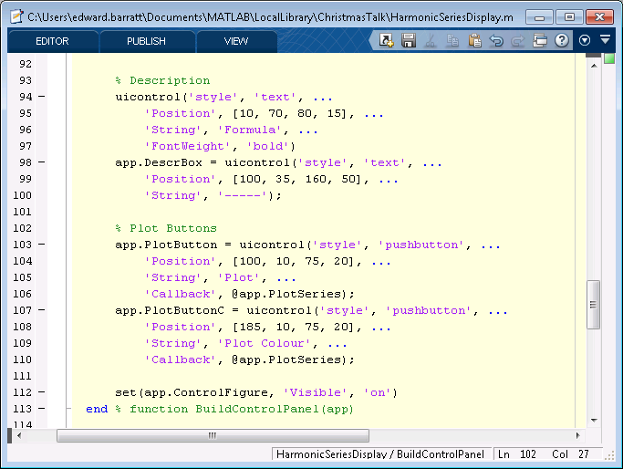
A GUI Class - callbacks
BuildControlPanel method
Why GUIs?
Object Oriented
A GUI Class
Constructor
Callbacks
In Action
Two different ‘pushbutton’ uicontrols to plot the harmonic series.
Both calling the same ‘PlotSeries’ method.

Slide 14
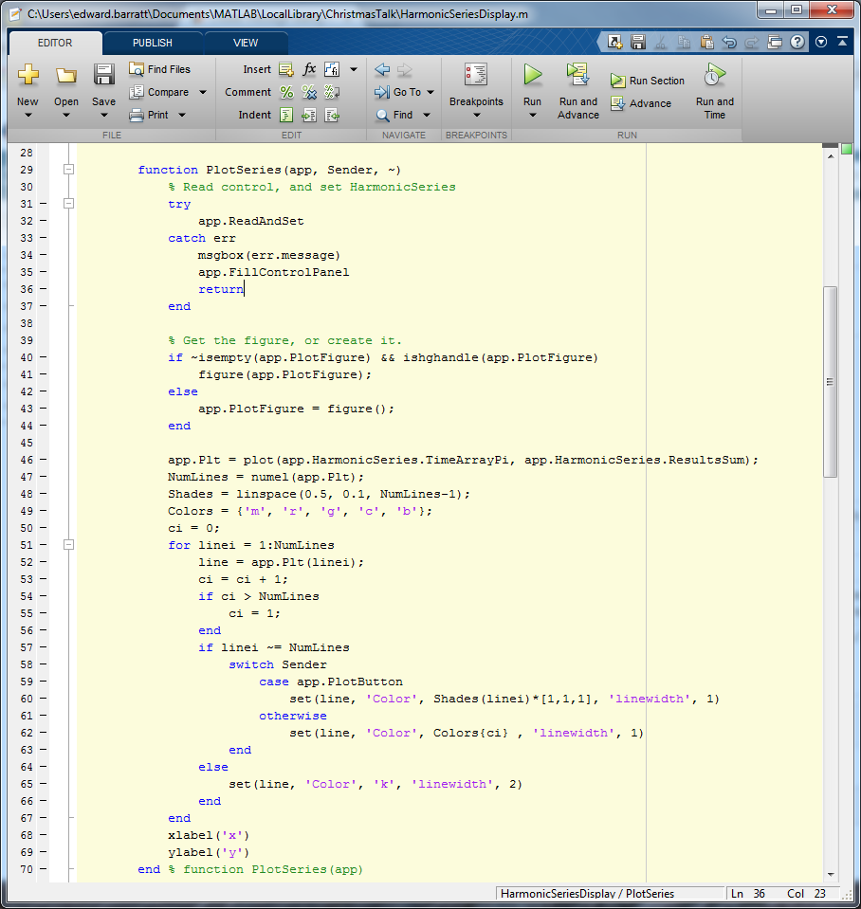
A GUI Class - callbacks
PlotSeries method
Read the contents of the GUI and set the HarmonicSeries object to take the appropriate values.
Why GUIs?
Object Oriented
A GUI Class
Constructor
Callbacks
In Action
Open a figure, or get it if it’s already been opened.
Plot the lines.
The “Sender” argument is used to control the line colours

Slide 15
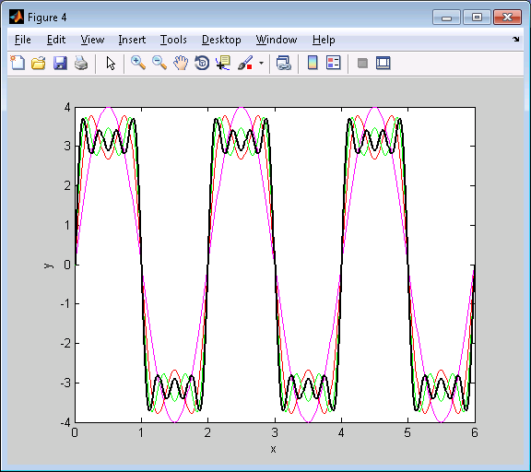
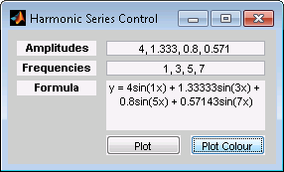
A GUI Class - In Action
Why GUIs?
Object Oriented
A GUI Class
Constructor
Callbacks
In Action
https://github.com/EddyTheB/HarmonicSeries

